Slide 1


Session no.17
Subject: Engineering Chemistry
Course Code: ETCH104
Program: B.Tech. CSE (Full Stack/IBM/DS) SEM-I
Faculty Name: Dr. Divyanshi Mangla
(Assistant Professor)
School of Basic and Applied Sciences

Slide 2

Table of Contents
Pre-requisite
Battery and its Types
Primary battery
Secondary battery
Quiz
Support Material

Slide 3
Pre-requisite
Basic knowledge of Class 12th Chemistry
Electrode potential
Redox reactions
EMF
Batteries

Slide 4
Course Outcomes
CO1 | Understand the methods for water hardness and the basics of boiler water treatment and analyze fuel calorific values and battery. | BTL2
CO2 | Explain the characteristics and working principles of different battery types and types of fuels. | BTL2
CO3 | Determine the differences between batteries and fuel cells and classify fuel cell types based on their components. | BTL4
CO4 | Identify between hard and soft water, solve the related numerical problems on water purification and emf and its significance in industry and daily life. | BTL3

Slide 5
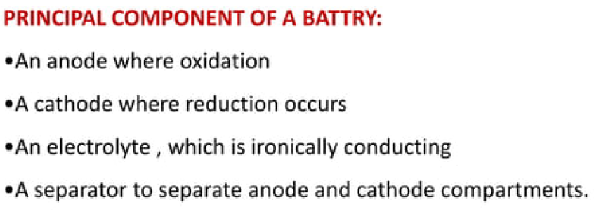
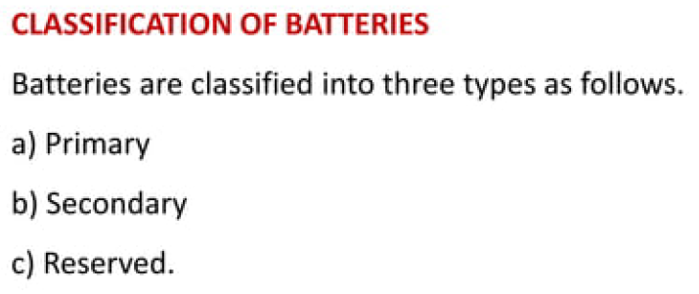
Batteries
Batteries are devices that store electrical energy in the form of chemical energy.
Batteries consist of one or more galvanic cells connected in series.
Notes:
New Courses replaced with New Programmes

Slide 6
Primary batteries
Primary batteries are non-rechargeable batteries.
The chemical reaction in a primary battery is irreversible.
Once a primary battery is discharged, it cannot be recharged.
Examples of primary batteries include:
Alkaline batteries
Carbon-zinc batteries
Lithium batteries
Notes:
New Courses replaced with New Programmes

Slide 7
Secondary batteries
Secondary batteries are rechargeable batteries.
The chemical reaction in a secondary battery is reversible.
Secondary batteries can be recharged by applying an external voltage.
Examples of secondary batteries include:
Lead-acid batteries
Nickel-cadmium batteries
Lithium-ion batteries
Notes:
New Courses replaced with New Programmes

Slide 8
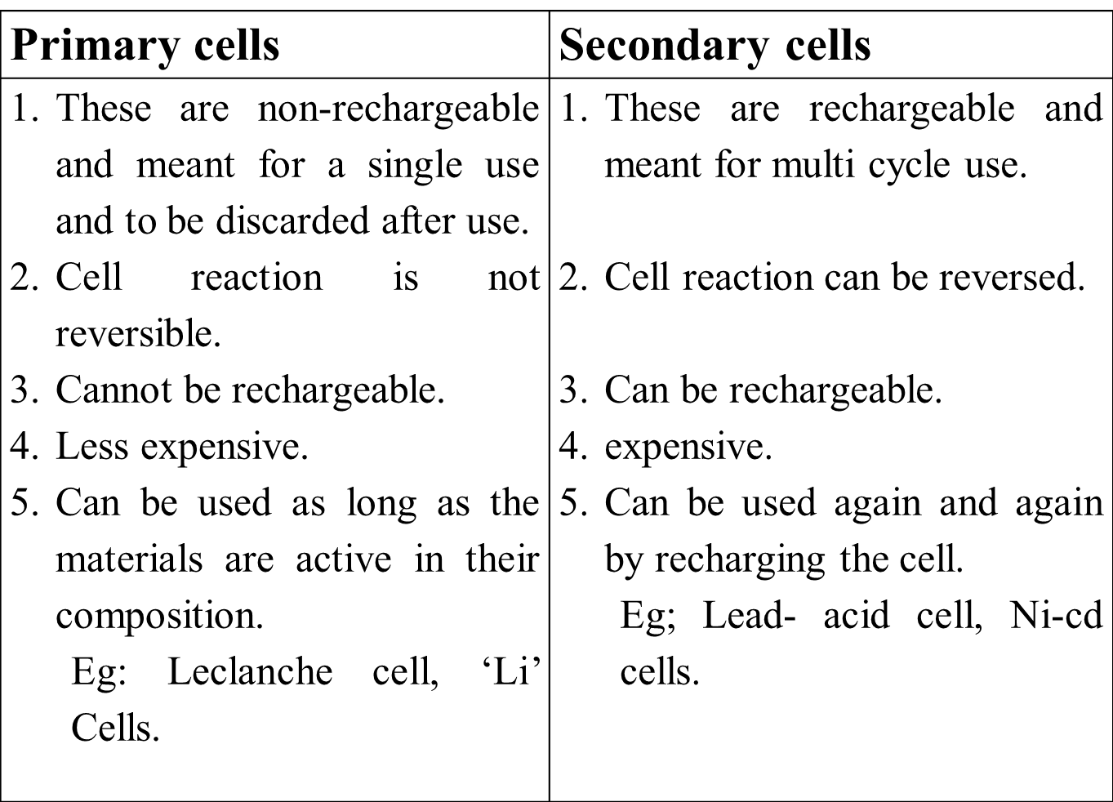
Differences between Primary and secondary batteries
Notes:
New Courses replaced with New Programmes

Slide 9
Reserve batteries
Reserve batteries are activated when they are needed.
The electrolyte in a reserve battery is separated from the electrodes until the battery is activated.
Reserve batteries are used in applications where long shelf life and reliability are important.
Examples of reserve batteries include:
Silver-oxide batteries
Lithium-thionyl chloride batteries
Notes:
New Courses replaced with New Programmes

Slide 10

Daily Quiz – Batteries and Their Types
Q1. MCQ Which of the following is a primary battery? a) Nickel-Cadmium battery b) Lead-acid battery c) Mercury battery d) Lithium-ion battery Correct Answer: c) Mercury battery
Q2. MCQ Which battery is rechargeable and commonly used in electric vehicles? a) Mercury cell b) Lead-acid battery c) Zinc-carbon battery d) Dry cell Correct Answer: b) Lead-acid battery
Q3. Short Answer What is the main difference between a primary and a secondary battery? Answer: Primary batteries are non-rechargeable and used once; secondary batteries are rechargeable.

Slide 11
Q4. MCQ In a lithium-ion battery, lithium ions move: a) From cathode to anode during discharge b) From anode to cathode during discharge c) From electrolyte to anode d) Only during charging Correct Answer: b) From anode to cathode during discharge
Q5. Short Answer Write one key application each for the following: - Ni-Cd battery - Lithium-ion battery Answer: Ni-Cd: Cordless tools; Li-ion: Mobile phones, EVs

Slide 12
📚 Key Takeaways:
Batteries are devices that convert chemical energy into electrical energy via redox reactions.
Primary batteries (e.g., dry cell, mercury cell) are non-rechargeable and used once.
Secondary batteries (e.g., lead-acid, Ni-Cd, Li-ion) are rechargeable and used in portable and large-scale devices.
Lead-acid batteries are commonly used in vehicles due to high current output and low cost.
Nickel-Cadmium (Ni-Cd) batteries have good charge-discharge cycles but suffer from the memory effect.
Lithium-ion batteries offer high energy density, long life, and are widely used in electronics and EVs.
The working principle involves movement of ions between electrodes during charging and discharging.
Battery performance depends on electrode materials, electrolytes, cycle life, energy density, and safety.

Slide 13
📚 Textbook References
Author | Book Title | Publisher | Relevant Chapter/Pages
P.W. Atkins & Julio de Paula | Physical Chemistry | Oxford University Press | Ch. 19: Electrochemistry, pp. 670–692
K.L. Kapoor | Electrochemistry & Solutions (Vol. 3) | Macmillan India | Ch. 5: Batteries, pp. 120–140
Bahl & Tuli | Essentials of Physical Chemistry | S. Chand Publishing | Ch. 9: Electrochemical Cells and Batteries, pp. 670–690
Sharma & Kaur | Physical Chemistry | Krishna Prakashan | Ch. on Batteries & Fuel Cells
Gurdeep Raj | Advanced Physical Chemistry | Goel Publishing | Section: Batteries and Storage Cells

